Slide 1

MP RAIR
MULTI-PURPOSE RESCUE AND INVESTIGATION ROBOT
İHSAN IŞIK
FEHIM TRNKA

Slide 2
Bosnia and Herzegovina…

Slide 3
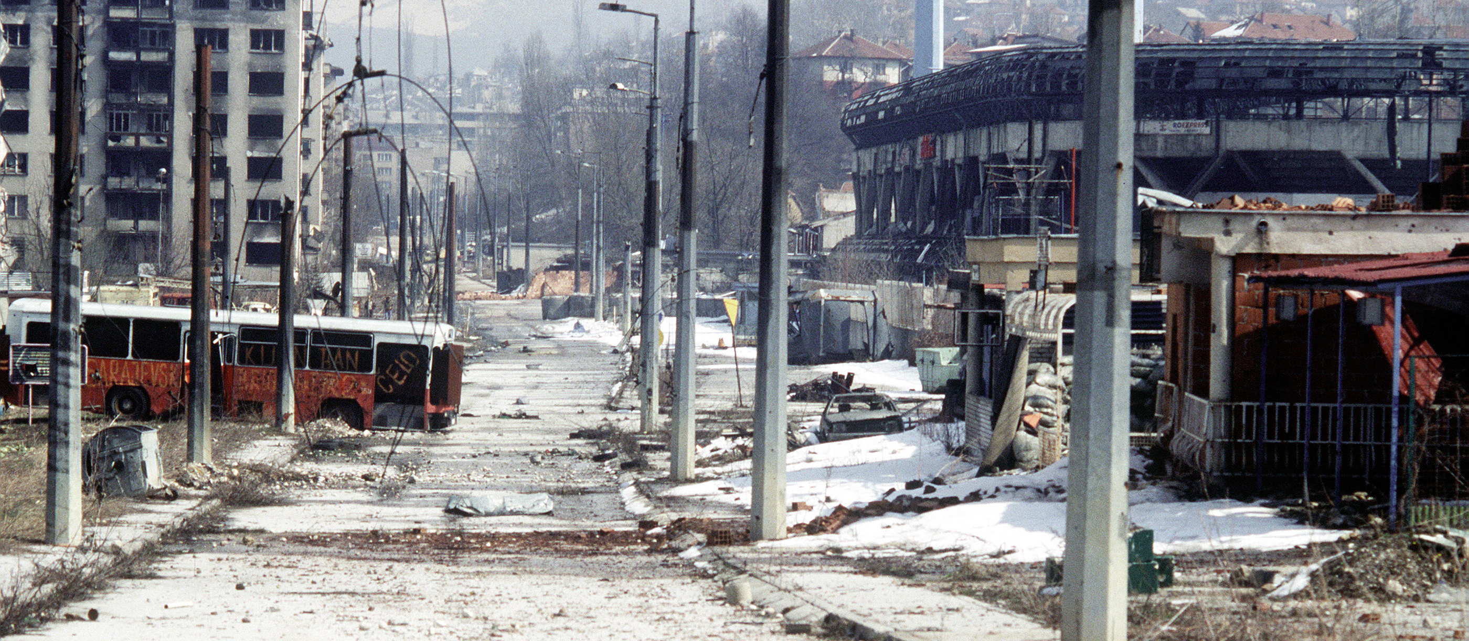
BOSNIAN WAR
The Bosnian War was an international armed conflict that took place in Bosnia and Herzegovina between 1 March 1992 and 14 December 1995. The main belligerents were the forces of the Republic of Bosnia and Herzegovina and those of the self-proclaimed Bosnian Serb and Bosnian Croat entities within Bosnia and Herzegovina, Republika Srpska and Herzeg-Bosnia, who were led and supplied by Serbia and Croatia respectively.

Slide 4
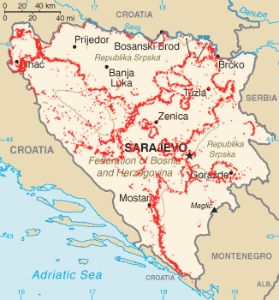
LAND MINES IN BOSNIA
As an after effect of the war land mines laid by all combatants remained leaving Bosnia and Herzegovina with one of the most severe land mine problems of the world.

Slide 5
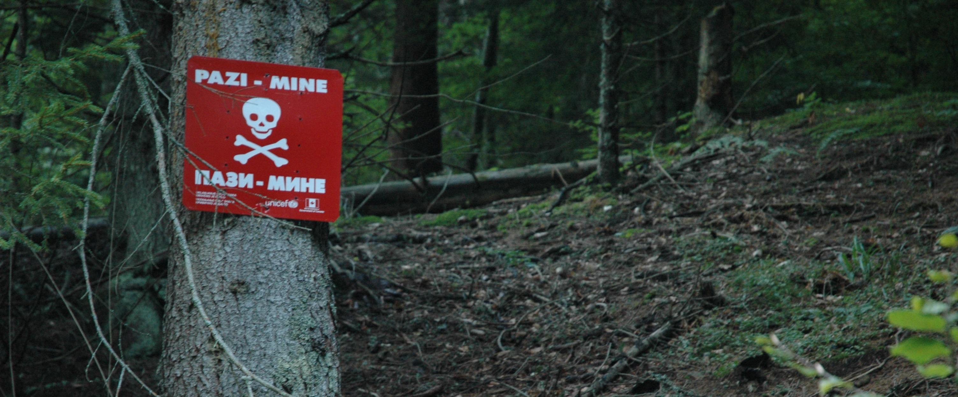
220,000 land mines and unexploded munitions remain scattered in 13,077 locations. A total of 1,755 km².
(3,4% of the Bosnia's whole territory)

Slide 6
CASUALTIES
Land mine casualties in Bosnia and Herzegovina 1996-2009
Year | Killed | Injured | Total
1996 | 110 | 552 | 662
1997 | 88 | 202 | 290
1998 | 60 | 80 | 149
1999 | 38 | 57 | 95
2000 | 35 | 65 | 100
2001 | 32 | 55 | 87
2002 | 26 | 46 | 72
2003 | 23 | 31 | 54
2004 | 16 | 27 | 43
2005 | 10 | 9 | 19
2006 | 18 | 17 | 35
2007 | 8 | 22 | 30
2008 | 19 | 20 | 39
2009 | 9 | 19 | 28
2010 | 6 | 8 | 14
Totals | 498 | 1,210 | 1,717
Source: Land mine contamination in Bosnia and Herzegovina, Wikipedia. 14:40, 10 August 2012.‎

Slide 7
Mine Sweeping…
The process of detecting mines in an area.

Slide 8
METHODS
Manual detection with a metal detector
The process of scanning the area with metal detectors.
Dogs
Well-trained dogs that sniff out explosive chemicals like TNT in landmines.
Rats
Giant pouched rats trained to sniff out chemicals like TNT in landmines. These rats are called HeroRATS. They have the advantage of being far lower mass than the typical human. They are less likely to set off small mines intended to injure or kill people, if the bomb-sniffing animal crosses directly over the top of a buried mine.
Mechanical clearance
Special machines that effectively combine mine detection and removal into one operation. These machines consist of a special vehicle that is driven through the minefield, deliberately detonating the mines it drives over. These vehicles are designed to withstand the explosions with little damage. Some are operated directly with armor to protect the driver; some are operated under remote control.

Slide 9
ACCIDENTS
12:55, 01/06/1999, Bosnia and Herzegovina/ Between Gajevi and Gornjani villages, RS SAMAC/BRVNIK Region. Full Report
NAME REMOVED, surveyor
severe Chest, severe Eye, severe Legs, LOST Toes, LOST Eye.
NAME REMOVED, deminer
severe Legs
NAME REMOVED, surveyor
FATAL
22/03/2008, Bosnia and Herzegovina/ Masici Village, Nr Goradze. Full Report
NAME REMOVED
FATAL
NAME REMOVED
FATAL
NAME REMOVED
FATAL
NAME REMOVED, civilian
Fragmentation Injuries
Sources:
DDAS Accident Report. Accident Number 207, 16/04/2004, http://www.ddasonline.com/PDF_files/DDASaccident207.pdf
DDAS Accident Report. Accident Number 717, 08/07/2011, http://www.ddasonline.com/PDF_files/DDASaccident717.pdf

Slide 10
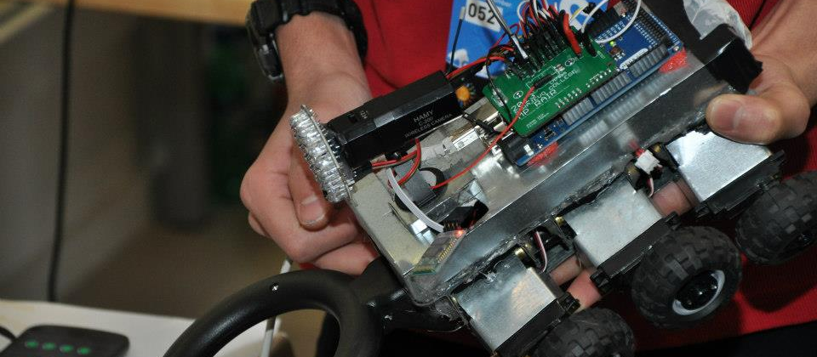
MP RAIR
MULTI-PURPOSE RESCUE AND INVESTIGATION ROBOT

Slide 11
A SIX WHEELED, REMOTELY CONTROLLED VEHICLE CAPABLE OF MINE SWEEPING AND PINNING DOWN THEIR LOCATION, REMOTE VIDEO TRANSMISSION, TEMPERATURE SENSING, ETC. THAT IS REMOTELY CONTROLLED BY MEANS OF WIRELESS COMMUNICATION…

Slide 12
METAL DETECTOR
A Metal Detector for detecting metal in mines.

Slide 13
WHEELS
3 independent wheels per side (six in total) increase traction. In other words, they provide better grip to the surface on rough terrain…

Slide 14
NON-INDEPENDENT
INDEPENDENT
SOME WHEELS FAIL TO GET IN CONTACT WITH THE SURFACE.
ALL WHEELS ARE IN CONTACT WITH THE SURFACE. THUS, INCREASING TRACTION.
THIS MAKES IT EASIER FOR THE VEHICLE TO GO OVER ROCKS AND BUMPS ON THE SURFACE.

Slide 15
WIRELSESS CAMERA
A wireless camera attached to the front of the vehicle serves as a vision provider for the remote operator and is capable of capturing frames of the environment.

Slide 16
MOTORS
MP RAIR uses Modified Servo Motors rather than DC Motors for more torque at the cost of speed.

Slide 17
GPS
A [name or model] GPS Module used for location and speed information.

Slide 18
WIRELESS COMMUNICATION
Wireless Communication is handled by 2 nRF24L01modules connected to 2 Arduino Boards.

Slide 19
PCB
The Printed Circuit Board (PCB) is the component that holds all these components together in a tidy, organized way providing the necessary wiring with each other and Arduino.

Slide 20
THE BRAIN – ARDUINO
Arduino is so called “the brain” of MP RAIR. It gets components work in harmony. It’s the thing that does the calculations and acts accordingly when necessary.

Slide 21
WORK FLOW
Controlling Device
Sends commands to Arduino on how to move and interact. In the meantime it also receives information about mine coordinates, vehicle location…
Metal Detector
Signals Arduino upon mine detection.
Provides communication between master and robot.
Wireless
Arduino Mega
GPS
Provides information such as coordinates and speed.
Arduino Mega
As the brain of the robot it acts upon data received from either the Metal Detector or the Wireless module by issuing commands to the motors or first obtaining GPS data and then sending those data to the master (Controlling Device) over Wireless.
Motors
Provide movement to the vehicle according to commands issued by Arduino.

Slide 22
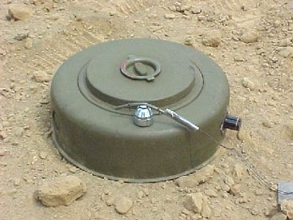
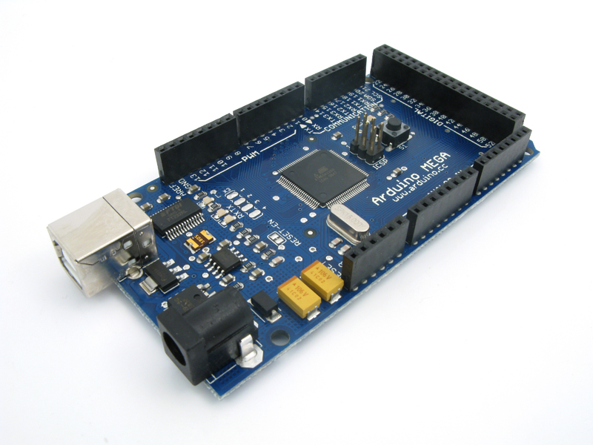
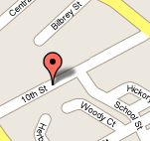


UPON MINE DETECTION
Mine Detected
5 Volts are output to Arduino
Arduino is immediately alerted after receiving Voltage at its analog read pin and therefore goes on to obtain GPS data
Arduino receives GPS data and sends them to nRF24L01 (Wireless) to be sent to the Master.
Wireless Module sends these data to the Master letting it know about the mine and it’s location.
As the final step the Computer processes these data and pinnes the location of mine accordingly.
5V→

Slide 23
Well, what if…

Slide 24
YOUR ROBOT PASSES RIGHT OVER THE MINE?
Pressure/Weight required to trigger a land mine is 11-35.3 pounds (5-16KG) for Anti-Personnel mines. As for Anti-Tank mines, they require even higher pressure as they are designed for tanks and vehicles. Our robot being only X Kilograms is very unlikely to cause a mine explosion.
In the worst case, it’s still better than having a human detonate it.
X < 5

Slide 25
NOT ALL MINES ARE COMPLETELY METAL. AND YOU’RE USING A METAL DETECTOR…
Yes, at some point this is correct. But according to Wikipedia; “Mines manufactured after the 1950s generally use plastic casings to hinder detection by electronic mine detectors. Some, referred to as Minimum metal mines, are constructed with as little metal as possible. Mines containing absolutely no metal have been produced, but are uncommon.”.

